Slide 1
Introduction to multi-point machining processes: Milling
Lecture 24

Slide 2
Introduction to multi-point machining processes
Multi-point machining is a material removal process that uses a cutting tool with multiple cutting edges to simultaneously engage the workpiece and remove material.
Key Features:
Multiple Cutting Edges: The tool has more than one cutting edge (e.g., milling cutter, broach, drill).
Intermittent Cutting: Often involves intermittent contact between tool and workpiece (especially in milling).
Higher Material Removal Rate: Due to multiple edges working at once, material removal is faster compared to single-point tools.

Slide 3
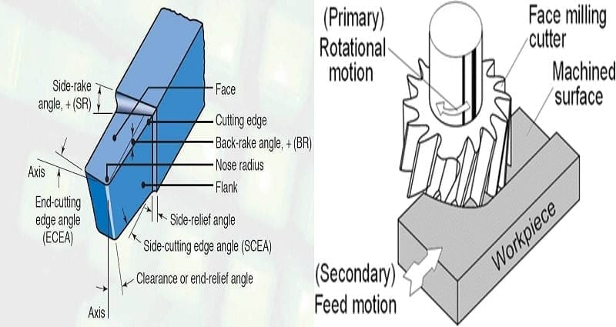
Single-point vs Multi-point Machining Processes
Criteria | Single-point | Multi-point
Example | Turning | Milling
Tool | One cutting edge | Multiple cutting edges
Material Removal | Continuous | Intermittent
Tool Life | Longer | Shorter (varies)
Single-point Multi-point

Slide 4
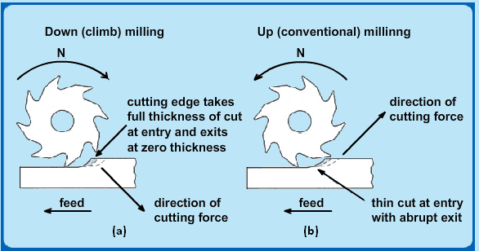
What is Milling?
Definition: A machining process using a rotating tool with multiple cutting edges to remove material.
Intermittent cutting process.
Workpiece is fed against the rotating cutter.

Slide 5
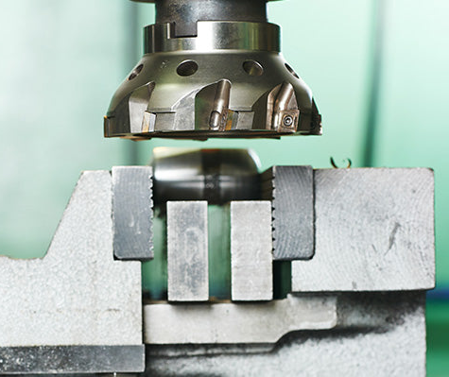
Principle of Milling
Milling operations involve using multi-point rotary cutters to remove material from a workpiece.
Tool rotates → workpiece feeds into cutter
Intermittent cutting → multiple edges engage sequentially
Better tool life & efficiency compared to single-point tools

Slide 6
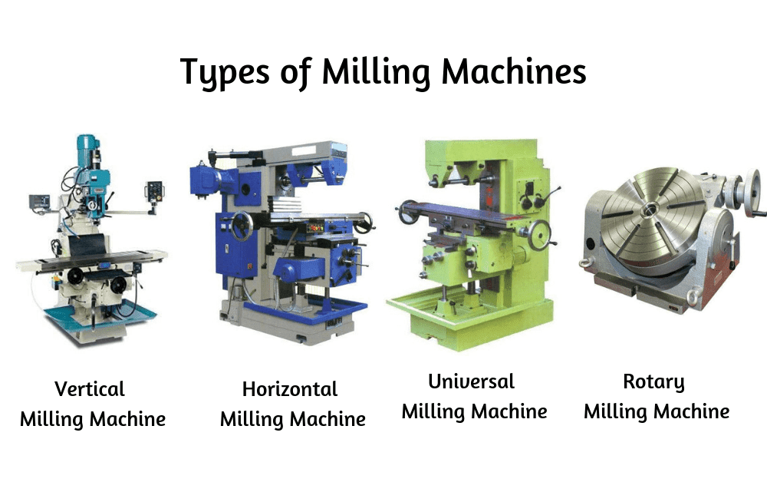
Classification of Milling Machines
Vertical milling machine Horizontal milling machine
Universal milling machine Rotary milling machine

Slide 7
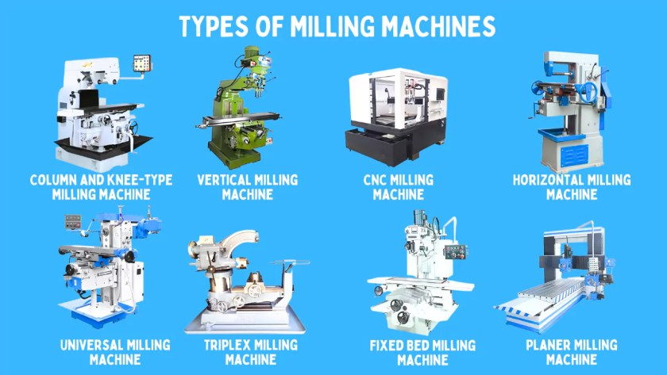
Classification of Milling Machines Cont…

Slide 8
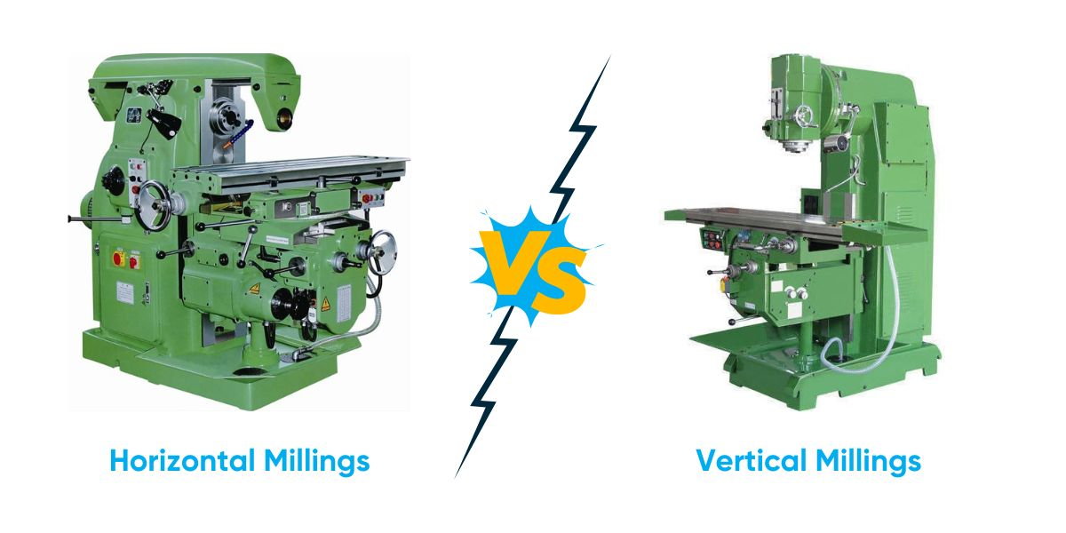
Horizontal vs. Vertical Milling
Feature | Horizontal | Vertical
Spindle Orientation | Horizontal | Vertical
Applications | Heavy cuts | Surface/contour milling
Tool Access | From side | From top

Slide 9
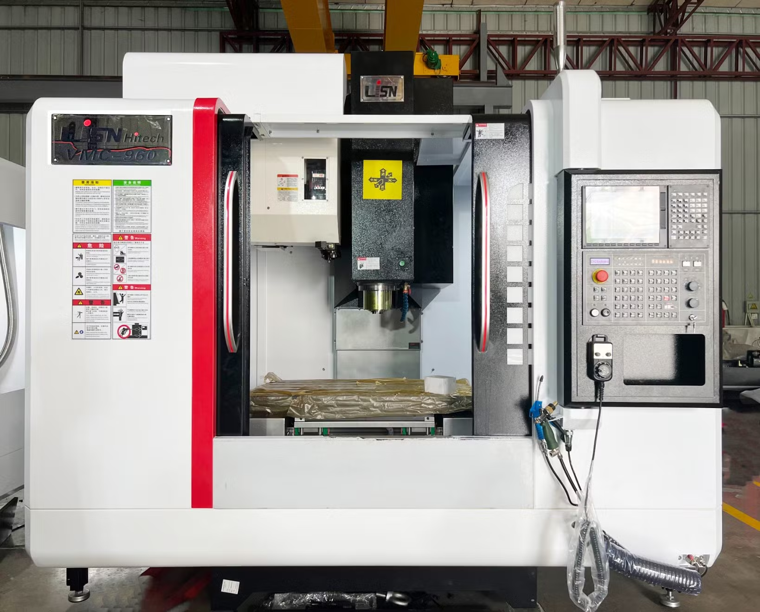
CNC Milling Machines
Computer Numerical Control (CNC)
High precision, automation
Used for complex geometries
Multiple axes (3, 4, or 5-axis machining)

Slide 10
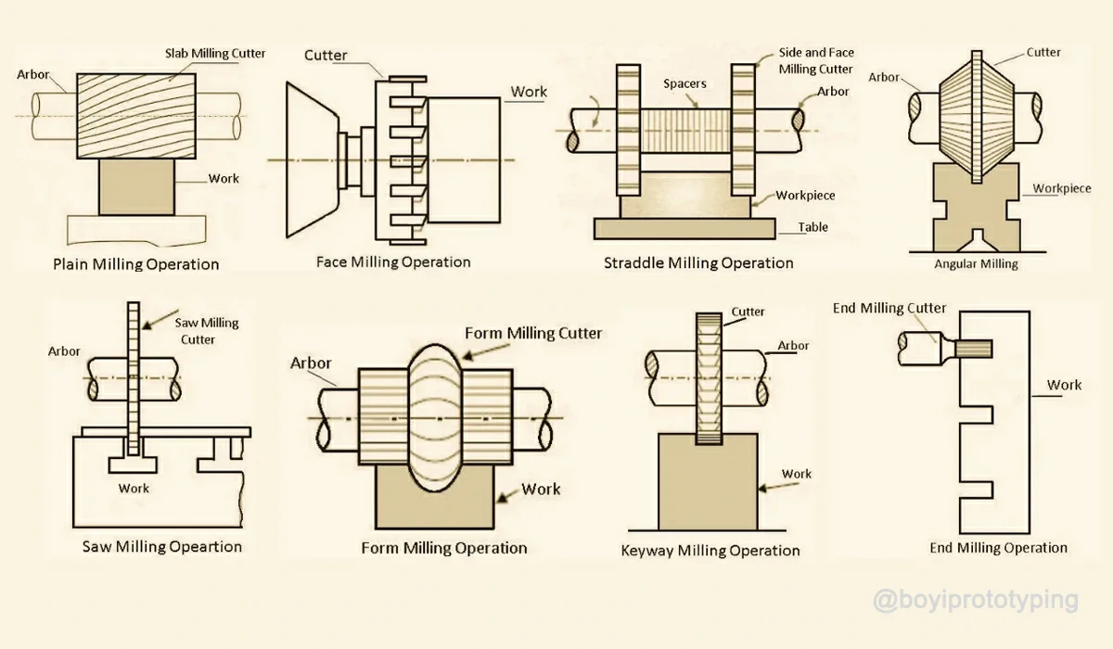
Types of Milling Operations
Face milling
Slab (peripheral) milling
Slot milling
Contour milling
Pocket milling

Slide 11
CNC Milling Machines
Milling Operation | Description | Advantages | Typical Applications
Face Milling | Cuts a flat surface on the top of a workpiece. | High material removal rate; smooth finish | Flat surfaces, molds, machine bases
Plain (Slab) Milling | Pays an entire flat area, often for rough cutting. | Consistent stock removal; cost-effective | Removing large amounts of material; rough cuts
Side Milling | Cuts along the edge or side of a workpiece. | Creates precise flat side profiles | Grooves, slots, shoulders
Straddle Milling | Mills two parallel surfaces at once. | Fast production of parallel slots | Jigs, fixtures, gear spaces
Gang Milling | Uses multiple cutters on one arbor for varied ops. | Multiple features in one setup | Engine blocks, transmission housings
Angle Milling | Cuts at specific angles or chamfers. | Precise angled surfaces; bevels | T-slots, chamfers, angled features
Form Milling | Shapes irregular contours or profiles. | Accurate complex shapes | Turbine blades, orthopedic implants
End Milling | Feeds workpiece into an end mill for various shapes. | Great for detailed profiles; good finish | Pockets, slots, complex pockets
Saw Milling | Uses a large, circular cutter to cut slots. | Effective for deep slots and parting off | Cutting off parts; slotting
Gear Milling | Cuts gear teeth using form tools or hobs. | Very precise gear shapes | All types of gear production
Thread Milling | Cuts internal or external threads via interpolation. | Flexible thread sizes; no chip jamming | Fasteners, internal threads in engines
CAM Milling | Shapes cam profiles for mechanical cams. | Precise cam geometry; smooth surfaces | Cams in engines and machinery
Profile Milling | Follows a defined outline on a workpiece. | Accurate edge and contour cutting | Complex part outlines, decorative edges
Shoulder Milling | Creates a shoulder or step in the workpiece. | Square corners; precise height steps | Shoulders, stepped features
Cylindrical Milling | Produces round or cylindrical shapes. | Accurate round profiles; consistent sizes | Shafts, rollers, cylindrical housing parts
Micro Milling | Uses very small cutters for fine detail. | High precision on tiny features | Micro parts, electronics components
Plunge Milling | Plunges the cutter straight down into the material. | Fast pocketing; deep hole preparation | Deep pockets, initial entry holes
Helical Milling | Cuts holes or features in a helical pattern. | Smooth hole walls; flexible hole sizes | Large hole making, helical slot cutting
Slot Milling | Uses a rotating cutter to make a straight groove in a workpiece. | High material removal rate for efficient slotting | Slots, grooves

Slide 12
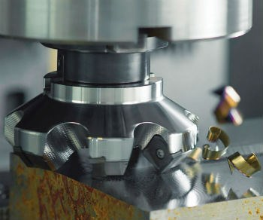
Face Milling
Cutting occurs on the face of the cutter
Produces flat surfaces
Cutter axis perpendicular to workpiece surface

Slide 13
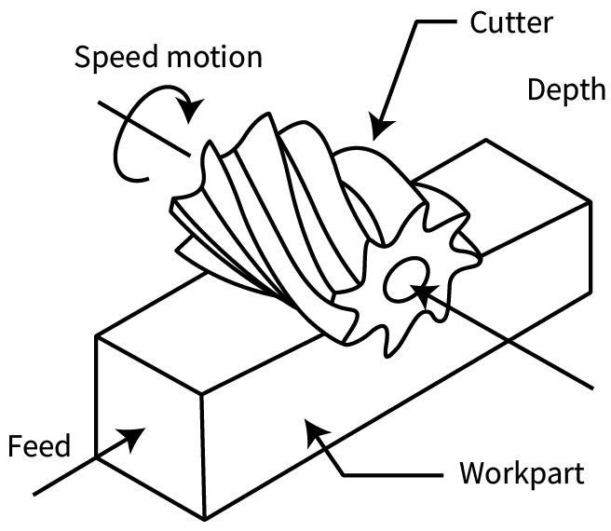
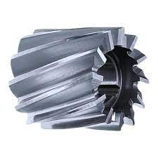
Peripheral (Slab) Milling
Cutting on the periphery of the tool
Used for large surfaces
Produces smoother finish along the sides

Slide 14
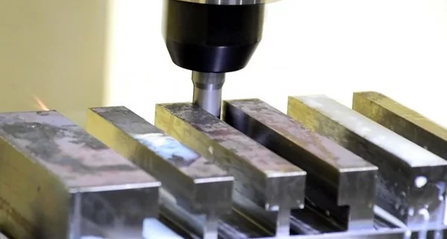
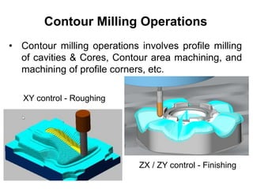
Slot & Contour Milling
Slot milling: Produces narrow grooves
Contour milling: Used for curved or complex profiles (CNC often used)

Slide 15
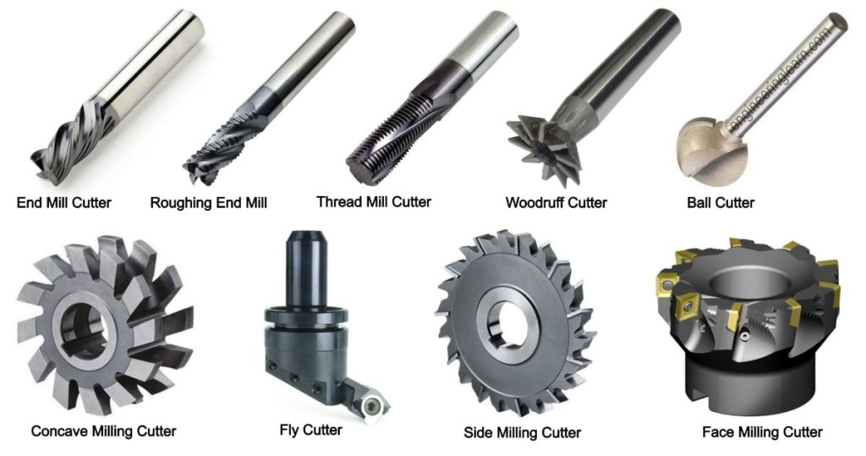
Milling Tools and Cutters
End mills
Face mills
Slab mills
Material: HSS, Carbide, Coated tools
Cutter selection based on material and operation

Slide 16
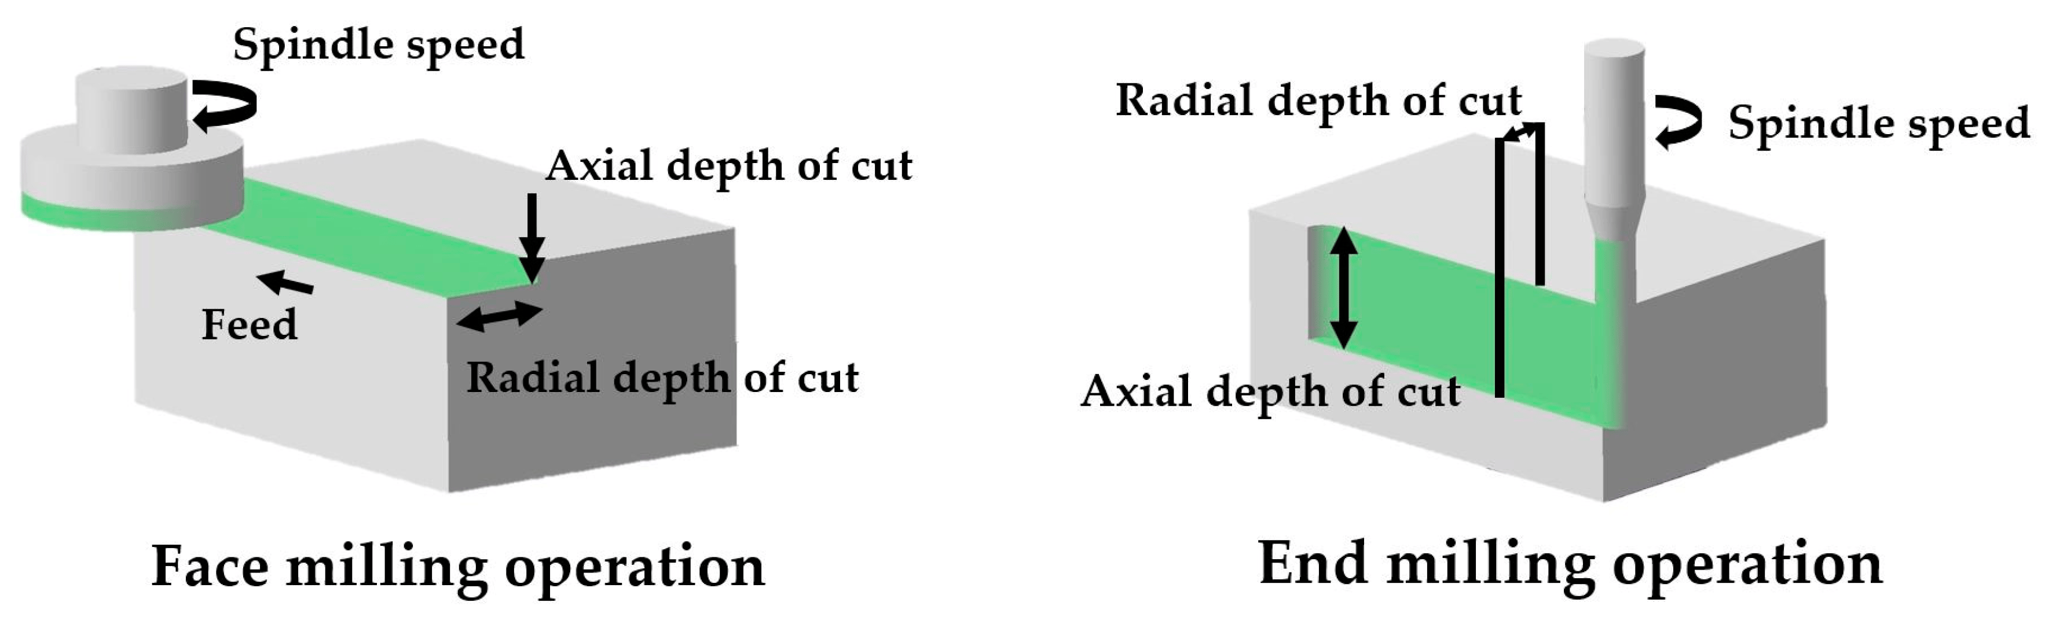
Cutting Parameters in Milling
Spindle speed (RPM)
Feed rate (mm/min)
Depth of cut
Cutting speed
Proper parameter selection ensures:
  Good surface finish
  Tool life
  Efficient machining

Slide 17
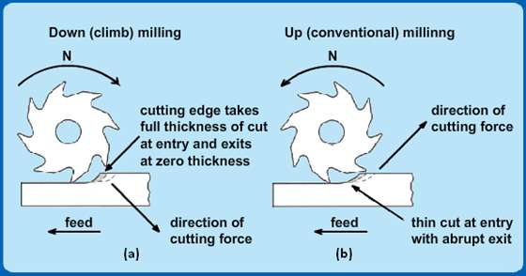
Climb vs Conventional Milling
Type | Climb Milling | Conventional Milling
Chip Direction | Thick to thin | Thin to thick
Tool Load | Decreasing | Increasing
Surface Finish | Better | Rougher
Climb preferred in CNC

Slide 18
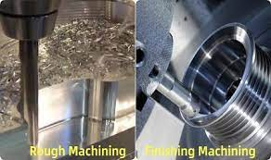
Surface Finish in Milling
Influenced by:
  Tool geometry
  Cutting speed & feed
  Material hardness
  Vibration and chatter
Roughing vs Finishing passes

Slide 19
Advantages of Milling
Versatile – flat, angled, contoured surfaces
Suitable for different materials
High productivity (especially CNC)
Reusability of tools

Slide 20
Advantages of Milling Machines:
Flexibility: Milling machines are extremely flexible and can do a wide range of machining operations such as face milling, end milling, drilling, tapping, boring and slotting. It is through this flexibility that they are able to manufacture parts or components having different geometries and features which could be complex.
Accuracy: Milling machines have a high level of accuracy compared to other machining tools; it can therefore be used for achieving very close tolerances during the fabrication of high precision parts in industries like aerospace manufacturing, medical equipment manufacturing among others.
Efficiency: A single setup on a milling machine can complete multiple operations reducing manual intervention and set up changes. As a result time and costs savings in mass production related environments are achieved thereby raising efficiency.
Personalization: Machining techniques and cutting tool types that are diverse enable milling machines to offer customization based on specific requirements. Hence engineers as well as manufacturers are allowed to customize designs plus features so as to suit distinct applications.
Automation: Currently, computer numerical control (CNC) systems are fitted into modern CNC mills that automate the machining process. Consequently, precise control over the work position with respect to the tool path is achieved by controlling cutting parameters hence achieving consistent machining results.

Slide 21
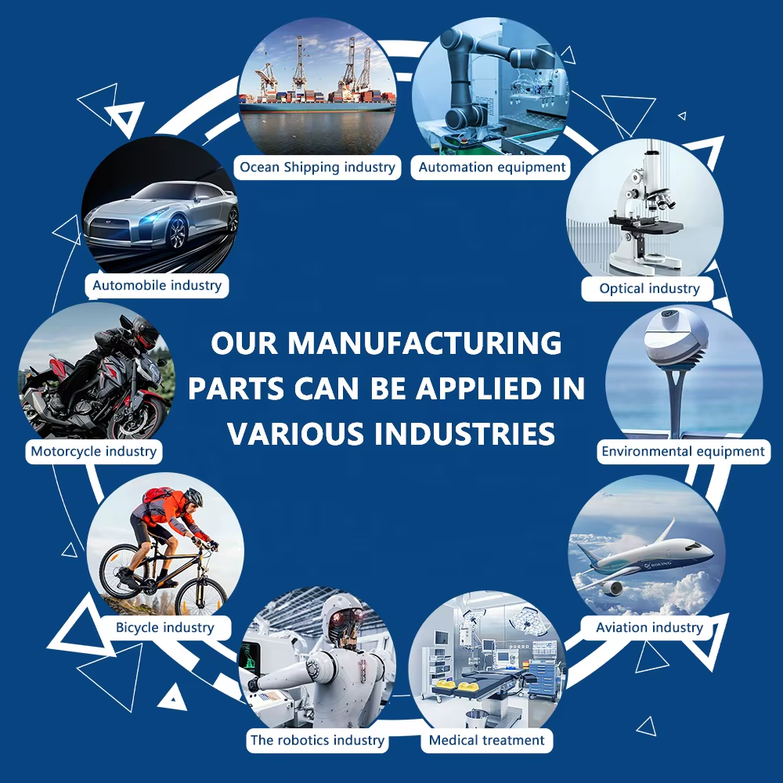
Applications of Milling
Automotive: Gearboxes, cylinder heads
Aerospace: Wing structures, turbine parts
Tool & die making
Electronics: Casings, components

Slide 22
References / Further Readings
[1] Ghosh, A. & Mallik, A.K.; Joining processes, Manufacturing Science, Latest edition.
[2] https://home.iitk.ac.in/~nsinha/Machining%20I.pdf
[3] Kalpakjian, S & Schmid, S,; Manufacturing Processes for Engineering Materials, Latest edition.
[4] https://home.iitk.ac.in/~vkjain/Lecture2-Metalcutting.pdf

Slide 23


